Slide 1
CSI1003 Formal Languages and Automata Theory
MODULE - 3
Dr. WI. Sureshkumar
Associate Professor
School of Computer Science and Engineering (SCOPE)
VIT Vellore
wi.sureshkumar@vit.ac.in
SJT413A34

Slide 2
Module -3
Regular Expressions and Languages:
Regular Expression
FA and Regular Expressions: FA to regular expression and regular expression to FA
Pattern matching and regular expressions
Regular grammar and FA
Pumping lemma for regular languages
Closure properties of regular languages
Linear grammars and linear languages.

Slide 3
Regular Expression
Let Σ be a given alphabet. Then
∅ , ε , and any a∈Σ are all regular expressions. These are called
primitive regular expressions.
2) If r₁ and r₂ are regular expressions, then
- r₁ + r₂ is a regular expression.
- r₁ ⋅ r₂ is a regular expression.
r₁* is a regular expression.
(r₁ ) is a regular expression.
3) A string is a regular expression, if and only if it can be derived from the primitive regular expressions by a finite number of applications of rules in (2).

Slide 4
Regular Expression
Check whether the given string is a regular expression,
={ a, b, c}, the string (a + b . c)* . (c + ∅)
r₁ = a , r₂ = b , r₃ = c
r₄ = r₂ . r₃ = b . c
r₅ = r₁ + r₄ = a + b . c
r₆ = (r₅) = (a + b . c)
r₇ = r₆* = (a + b . c)*
r₈ = ∅
r₉ = r₃ + r₈ = c + ∅
r₁₀ = (r₉)= (c + ∅)
r₁₁ = r₇ . r₁₀ = (a + b . c)* . (c + ∅)

Slide 5
Languages associated with regular expressions
The language L(r) denoted by a regular expression r is defined by the following rules,
∅ is a r.e denoting the empty set L (∅) = {∅}
ε is a r.e denoting the empty set L (ε) = {ε}
For any a∈Σ is a r.e denoting the set L (a) = {a}
If r₁ and r₂ are regular expressions, then
4) L (r₁ + r₂) = L{r₁} U L{r₂}
5) L (r₁ . r₂) = L{r₁}.L{r₂}
6) L ((r₁)) = L(r₁)
7) L (r₁*) = (L (r₁))*

Slide 6
Languages associated with regular expressions
Exhibit the language L(a* . (a + b)) in set notation
L(a* . (a + b)) = L(a*) . L( (a + b))
= (L(a))*. L(a + b))
= (L(a))*. L(a) U L(b)
= { a }*. { a } U { b }
= {ε, a, aa, aaa,. . . }. { a, b}
= {a, aa, aaa, aaaa,. . . ,b, ab, aab, aaab,. . . }

Slide 7
Languages associated with regular expressions
r = (a + b)*. (a + bb), find L(r)
L(r) = L((a + b)*. (a + bb))
= L((a + b)*). L(a + bb)
= (L(a + b))*. L(a + bb)
= (L(a) U L(b))* . L(a) U L(bb)
= {a, b}* . {a} U {b}.{b}
= {a, b}* . {a} U {bb}
= {a, b}* . {a, bb}
= {ε, a, b, aa, ab, ba, bb,. . .} . {a, bb}
= {a, aa, ba, aaa, aba, baa, bba,. . .,bb, abb, bbb, aabb, abbb, . . .}

Slide 8
Examples
Describe the following sets by regular expressions
L₁ = the set of all strings of 0’s and 1’s ending with 00
L₂ = the set of all strings of 0’s and 1’s and beginning with 0 and ending with 1
L₃ = {ε, aa, aaaa, . . . }
The set of all strings of 0’s and 1’s with at least two consecutive zeros
The set of all strings of a’s and b’s whose length is divisible by 6
The set of all strings of a’s and b’s whose 5th last symbol is b
The expression r = (aa)* (bb)*b denotes the set of strings with an even number of a’s followed by an odd number of b’s
L₄ = {a^{n} b^{m} / n ≥ 4 , m ≤ 3}

Slide 9
Examples
1) (0 + 1)*00
0(0 + 1)*1
(aa)*
(0 + 1)*00(0 + 1)*
[(a + b)⁶]*
(a + b)*b(a + b)⁴
7) L(r) = {a^{2n} b^{2m+1} / n ≥ 0 , m ≥ 0 }
8) aaaaa*(ε + b + bb + bbb)

Slide 10
Regular expression to ε-NFA
Theorem: Let r be a regular expression, then there exists some NFA with ε-moves that accept L(r). Consequently, L(r) is a regular language.
Proof: We begin with automata that accepts the language for primitive regular expressions ∅ , ε , and any a∈Σ
a) NFA accepts ∅
b) NFA accepts ε c) NFA accepts a∈Σ
q₀
q_{f}
ε
q₀
a
q_{f}
q₀
q_{f}

Slide 11
Regular expression to ε-NFA
ii) NFA accepts L(r)
iii) NFA accepts L(r₁+r₂)
M(r)
M(r₁)
ε
ε
M(r₂)
ε
ε

Slide 12
Regular expression to ε-NFA
iii) NFA accepts L(r₁.r₂)
iii) NFA accepts L(r₁*)
M(r₁)
M(r₂)
ε
ε
ε
M(r₁)
ε
ε
ε

Slide 13
Examples
The set of integers
(1+2+. . . +9)(0+1+. . . +9)*
2)The set of decimal numbers
(1+2+. . . +9)(0+1+. . . +9)*. (0+1+. . . +9)*
3) Strings over {a, b} and length multiple of 3
[(a + b)(a + b)(a + b)]*

Slide 14
Examples
(0 + 01)*
(a + b)*b(a + bb)*
(a+b)*abb
aa* + ab a*b*
(abab)* + (aa*+ b)*
((00*)*1)*
(01)* + 1(01)* + (01)*0 + 1(01)*0

Slide 15
(0 + 01)*
0
1
01
0
1
0
ε
1

Slide 16
0 + 01
(0 + 01)*
0
ε
ε
ε
ε
0
ε
1
ε
0
ε
ε
ε
ε
ε
ε
ε
0
ε
1
ε

Slide 17
(a + b)*b(a + b)*
a
b
a + b
a
b
a
ε
ε
ε
b
ε

Slide 18
(a+b)*
ε
a
ε
ε
ε
ε
ε
b
ε
ε

Slide 19
(a + b)*b(a + b)*
ε
ε
a
a
ε
ε
ε
ε
ε
b
ε
ε
ε
ε
ε
ε
b
ε
b
ε
ε

Slide 20
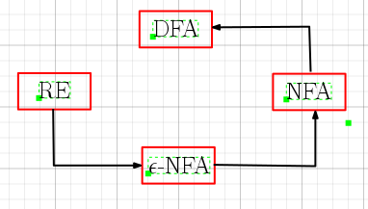

Slide 21
DFA to Regular Expressions
Theorem: If L = L(A) for some DFA A, then there is a regular expression r such that L = L(r)
Theorem: (Arden’s Theorem)
Let P and Q be two regular expressions over Σ. If P does not contain ε, then the following equation in R,
R = RP + Q
has unique solution, given by
R = P*Q

Slide 22
Algebraic Method using Arden’s Theorem
The following method is an extension of Arden’s theorem. It is used to find r.e recognized by the transition system.
The following assumptions are made regarding the transition system:
1) The transition system does not have ε-moves
2) It has one initial state say v₁
3) Its vertices are v₁ , v₂ , . . .,v_{n}
4) α_{ij} denotes the r.e representing the set of labels of edges from v_{i} to v_{j}, when there is no edge, α_{ij} = ∅. Consequently, we can get the following set of equations in v₁ , v₂ , . . .,v_{n}

Slide 23
Algebraic Method using Arden’s Theorem
v₁ = α₁₁ v₁+ α₁₂ v₂ + . . . .+ α_{1n} v_{n}
v₂ = α₂₁ v₁+ α₂₂ v₂ + . . . .+ α_{2n} v_{n}
. . . . . . . . . . . . . . . . . . . . . .
. . . . . . . . . . . . . . . . . . . . . .
v_{i} = α_{i1} v₁+ α_{i2} v₂ + . . . .+ α_{in} v_{n}
. . . . . . . . . . . . . . . . . . . . . .
. . . . . . . . . . . . . . . . . . . . . .
v_{n} = α_{n1} v₁+ α_{n2} v₂ + . . . .+ α_{nn} v_{n} + ε
By repeatedly applying substitutions and Arden’s theorem, we can express v_{i} in terms of α_{ij}

Slide 24
Examples
a
1)
Since there are 4 states namely q_{0 ,} q_{1 ,} q₂ and q₃ , therefore we have 4 equations,
q₀ = ε + a q₁ + b q₂ ----------- (1)
q₁ = b q₀ + a q₃ ----------- (2)
q₂ = a q₀ + b q₃ ----------- (3)
q₃ = a q₃ + b q₃ ----------- (4)
q₀
q₁
b
a
a
b
a , b
q₂
b
q₃

Slide 25
From (4),
q₃ = q₃ (a + b) + ∅
By applying Arden’s theorem,
q₃ = (a + b)* ∅ = ∅ -----------(5) a. ∅ = ∅
Sub. (5) in (2) and (3), we get a. ε = a
q₂ = a q₀ -----------(6)
q₁ = b q₀ -----------(7)
Sub. (6) and (7) in (1), we get
q₀ = ε + ab q₀ + ba q₀
= (ab + ba) q₀ + ε
By applying Arden’s theorem,
q₀ = (ab + ba)* ε = (ab + ba)*

Slide 26
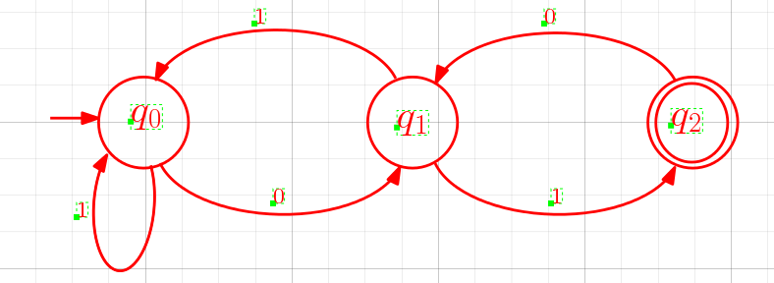
1) Construct the regular expression for the following FSA:
Since there are 3 states namely q_{0 ,} q₁ and q₂ , therefore we have 3 equations,
q₀ = 1 q₀ + 0 q₁ ----------- (1)
q₁ = 1 q₀ + 1 q₂ ----------- (2)
q₂ = ε + 0 q₁ ----------- (3)

Slide 27
Sub. (3) in (2), we get
q₁ = 1 q₀ + 1 (ε + 0 q₁)
= 1 q₀ + 1 + 10 q₁
= 10 q₁ + (1 + 1 q₀)
By applying Arden’s theorem,
q₁ = (10)* (1 + 1 q₀)
= (10)* 1 + (10)* 1 q₀ -----------(4)
Sub. (4) in (1), we get
q₀ = 1 q₀ + 0 [ (10)* 1 + (10)* 1 q₀]
= [1 + 0(10)* 1] q₀ + 0(10)* 1
By applying Arden’s theorem,
q₀= [1 + 0(10)* 1]* 0(10)* 1

Slide 28
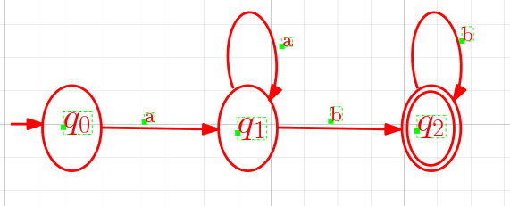
2)
Since there are 3 states namely q_{0 ,} q₁ and q₂ , therefore we have 3 equations,
q₀ = aq₁ ----------- (1)
q₁ = a q₁ + b q₂ ----------- (2)
q₂ = ε + b q₂ ----------- (3)

Slide 29
From (3),
q₂ = b q₂ + ε
By applying Arden’s theorem,
q₂ = b* ε = b* -----------(4)
Sub. (4) in (2), we get
q₁ = a q₁ + b b*
By applying Arden’s theorem,
q₁ = a* b b* -----------(5)
Sub. (5) in (1), we get
q₀ = a a* b b*

Slide 30
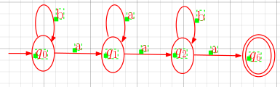
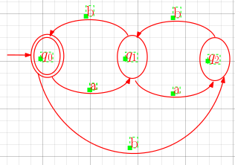
Find regular expressions for the languages accepted by the following automata:-
1)
2)

Slide 31
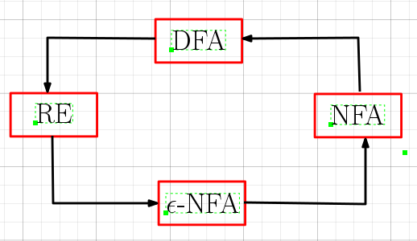

Slide 32
Pumping lemma for regular languages
Let L be an infinite regular language. Then there exists a positive integer n such that for any w∈L with |w|≥ n can be decomposed as
w = xyz
with |xy| ≤ n and |y| ≥ 1
such that
w_{i} = xy^{i}z is also in L for i = 0, 1, 2, . . .

Slide 33
Problems
Show that the following languages are not regular
1)
2)
3)
4)
is prime }
7)

Slide 34
1)
Assume that L is regular.
Let n be a positive integer.
Let . Then |w| = 2n ≥ n
Therefore, by pumping lemma w can be decomposed as
w = xyz with |xy| ≤ n and |y| ≥ 1
|xy| ≤ n xy contains only a’s
|y| ≥ 1 y = a^{k} , 1 ≤ k ≤ n
Consider, w₀ = xy⁰z = xz
But w = xyz = a^{n-k} a^{k} b^{n}
So, xz = a^{n-k} b^{n} , 1 ≤ k ≤ n
Therefore, w₀ = xz = a^{n-k} b^{n} L , a contradiction. Hence L is not regular.

Slide 35
2)
Assume that L is regular.
Let n be a positive integer.
Let . Then |w| = n² ≥ n
Therefore, by pumping lemma w can be decomposed as
w = xyz with |xy| ≤ n and |y| ≥ 1
Consider xy²z ,
n² = |xyz| ˂ |xy²z|= |xyz|+|y| ≤ n² + n ˂ n² + n + (n + 1) = (n+1)²
n² ˂ |xy²z| ˂ (n+1)²
Hence, |xy²z| is strictly lies between n² and (n+1)² but it is not equal to any one of them. Hence |xy²z| is not a perfect square.
Therefore, w₂ = xy²z L , a contradiction.
Thus L is not regular.

Slide 36
3)
Assume that L is regular.
Let n be a positive integer.
Let . Then |w| = n³ ≥ n
Therefore, by pumping lemma w can be decomposed as
w = xyz with |xy| ≤ n and |y| ≥ 1
Consider xy³z ,
n³ =|xyz| ˂ |xy³z|= |xyz|+|y²| ≤ n³ + n² ˂ n³ + n² + (2n² + 3 n + 1) = (n+1)³
n³ ˂ |xy³z| ˂ (n+1)³
Hence, |xy³z| is strictly lies between n³ and (n+1)³ but it is not equal to any one of them. Hence |xy³z| is not a perfect cube.
Therefore, w₃ = xy³z L , a contradiction.
Thus L is not regular.

Slide 37
4)
Assume that L is regular.
Let n be a positive integer.
Let . Then |w| = 2^{n} ˃ n
Therefore, by pumping lemma w can be decomposed as
w = xyz with |xy| ≤ n and |y| ≥ 1
Consider xy²z ,
2^{n} =|xyz| ˂ |xy²z|= |xyz|+|y| ≤ 2^{n} + n ˂ 2^{n+1}
2^{n} ˂ |xy²z| ˂ 2^{n+1}
Hence, |xy²z| is strictly lies between 2^{n} and 2^{n+1} but it is not equal to any one of them. Hence |xy²z| is not a power of 2.
Therefore, w₂ = xy²z L , a contradiction.
Thus L is not regular.

Slide 38
5) is prime }
Assume that L is regular.
Let n be a positive integer. Let p be a prime number greater than n i.e. p ˃ n .
Let . Then |w| = p ˃ n
Therefore, by pumping lemma w can be decomposed as
w = xyz with |xy| ≤ n and |y| ≥ 1
x, y, z are simple strings of a’s.
y = a^{m} , 1 ≤ m ≤ n
Let i = p +1 p = i -1
Consider
|xy^{i}z| = |xyz| + |y^{i - 1}| = |xyz| + |y|(i -1)
= p + m(i -1) = p + mp = (m+1)p , is not prime.
Therefore, xy^{i}z L , a contradiction.
Thus L is not regular.

Slide 39
6)

Slide 40
7)
Assume that L is regular. Let n be a positive integer with n ˃ 2.
Let . Then |w| = n! ≥ n
Therefore, by pumping lemma w can be decomposed as
w = xyz with |xy| ≤ n and |y| ≥ 1
x, y, z are simple strings of a’s.
y = a^{k} , 1 ≤ k ≤ n
|y| = k , 1 ≤ k ≤ n
Consider w₀ = xy⁰z = xz
| w₀ | = n! – k
The string xz ∈L if and only if there exists a j such that
n! – k = j!

Slide 41
But this is impossible, since n ˃ 2 and k ≤ n we have
n! – k ˃ (n-1)!
The existence of such j is impossible,
w₀ L , a contradiction.
Hence L is not regular.

Slide 42
Myhill - Nerode Theorem
The following three statements are equivalent:
The set L ⊆ Σ* is accepted by some FSA.
L is the union of some of the equivalence classes of a right invariant equivalence relation of finite index on Σ*.
Let equivalence relation R_{L} be defined by:
x R_{L} y if and only if for all z in Σ*, xz is in L exactly when yz is in L.
The R_{L} is of finite index.

Slide 43
Proof: (1) (2)
Assume that L is accepted by a DFA M = (Q, Σ, δ, q₀, F).
Define R_{M} on Σ*, as follows:
x R_{M} y if δ(q₀ , x) = δ(q₀ , x)
x R_{M} x if δ(q₀ , x) = δ(q₀ , x) (reflexive)
x R_{M} y if δ(q₀ , x) = δ(q₀ , y)
if δ(q₀ , y) = δ(q₀ , x)
y R_{M} x (symmetric)
3) x R_{M} y , y R_{M} z if δ(q₀ , x) = δ(q₀ , y) and if δ(q₀ , y) = δ(q₀ , z)
if δ(q₀ , x) = δ(q₀ , z)
x R_{M} z
This R_{M} is an equivalence relation on Σ*.

Slide 44
So, R_{M} divides Σ* into equivalence classes. The set of strings which take the machine from q₀ to a particular state q_{i} are in one equivalence class. The number of equivalence classes is therefore equivalent to the number of states in M. (assume every state is reachable from q₀ )
The index of R_{M} is at most the number of states of M. It can be easily seen that this equivalence relation R_{M} is right invariant.
x R_{M} y xz R_{M} yz for some z ∈ Σ*
x R_{M} y δ(q₀ , x) = δ(q₀ , y)
δ(q₀ , xz) = δ (δ(q₀ , x), z)
= δ (δ(q₀ , y), z)
= δ(q₀ , yz) xz R_{M} yz

Slide 45
Proof: 2 3
Assume E be an equivalence relation as defined in (2).
( E is an equivalence relation on Σ* with a finite index right invariant and L is union of some of the equivalence classes)
To show E is a refinement of R_{L}
if x E y then xz E yz for any z ∈ Σ*
xz and yz are in same equivalence class of E. Hence xz and yz are both in L or both not in L as L is the union of some of the equivalence classes of E.
Hence x R_{L} y
Hence, any equivalence class of E is completely contained in an equivalence class of R_{L}

Slide 46
Therefore, E is a refinement of R_{L} and so the index of R_{L} is less than or equal to the index of E and hence finite.
index of R_{L} ≤ index of E
(3) (1)
First, we show R_{L} is right invariant
x R_{L} y if xz ∈ L yz ∈ L
xwz ∈ L ywz ∈ L , w, z
xw R_{L} yw
R_{L} is right invariant.
Define M’ = (Q’, Σ, δ’, q₀’ , F’) as follows:

Slide 47
For each equivalence class of R_{L} , we have a state in Q’.
|Q’| = index of R_{L}
x ∈ Σ*, [x] denote the equivalence class of R_{L} to which x belongs to [x].
q₀’ = [ε]
δ’([x], a) = [xa]
This definition is consistent because R_{L} right invariant.
F’ = { [x] / x ∈ L}
Therefore, this automation M’ accepts L.

Slide 48
Problems
1) L = {a^{n}b^{n} / n ≥ 1}
2) L = {ww^{R}u / u, w ∈{0, 1}* }
3) L = {0^{i}1^{j} / gcd(i , j) = 1}
4) L = {a^{n}ba^{n} / n ≥ 1}

Slide 49
1) L = {a^{n}b^{n} / n ≥ 1}
Assume that L is regular.
Then by Myhill-Nerode theorem, L is a union of some of the equivalence classes of a right invariant equivalence relation of finite index on Σ*.
Consider,
a, a² , a³ , a⁴ , . . . .
each one cannot be in different equivalence class.
a^{n} a^{m} , m ≠ n - belongs to same equivalence class
Because of right invariance,
a^{n}b^{n} a^{m}b^{n}
This implies a^{n}b^{n} and a^{m}b^{n} both in same equivalence class or not both in same equivalence class.
But a^{n}b^{n} ∈ L , L should contain the whole equivalence class.
a^{m}b^{n} ∈ L, m ≠ n , this is a contradiction. Hence L is not regular.

Slide 50
2) L = {ww^{R}u / u, w ∈{0, 1}* }
Assume that L is regular.
Then by Myhill-Nerode theorem, L is a union of some of the equivalence classes of a right invariant equivalence relation of finite index on Σ*.
Consider,
(01), (01)² , (01)³ , (01)⁴ , . . . .
each one cannot be in different equivalence class.
For some m, n with m ≠ n
(01)^{n} and (01)^{m} belongs to same equivalence class, we write this as
(01)^{n} (01)^{m}
Let n < m , because of right invariance
(01)^{n} (10)^{n} 0 (01)^{m} (10)^{n} 0

Slide 51
Since (01)^{n} (10)^{n} 0 ∈ L , we conclude that (01)^{m} (10)^{n} 0 ∈ L .
But (01)^{m} (10)^{n} 0 is not of the form ww^{R}u , a contradiction.
Therefore, L is not regular.

Slide 52
3) L = {0^{i}1^{j} / gcd(i , j) = 1}
Suppose L is regular.
Consider the set of primes {p₁, p₂, p₃, . . . . } , this is an infinite set.
Consider the set of strings 0^{p1}, 0^{p2}, 0^{p3}, . . . . By Myhill-Nerode theorem, all of them cannot be in different equivalence classes.
For some p_{i} and p_{j} , 0^{pi} and 0^{pj} must be in the same equivalence class.
0^{pi} 0^{pj}
0^{pi} 1^{pj} 0^{pj} 1^{pj}
0^{pi} 1^{pj} ∈ L where as 0^{pj} 1^{pj} L , a contradiction.
Hence L is not regular.

Slide 53
4) L = {a^{n}ba^{n} / n ≥ 1}
Assume that L is regular.
Then by Myhill-Nerode theorem, L is a union of some of the equivalence classes of a right invariant equivalence relation of finite index on Σ*.
Consider,
a, a² , a³ , a⁴ , . . . .
each one cannot be in different equivalence class.
a^{n} a^{m} , m ≠ n - belongs to same equivalence class
Because of right invariance,
a^{n}ba^{n} a^{m}ba^{n}
This implies a^{n}ba^{n} and a^{m}ba^{n} both in same equivalence class or not both in same equivalence class.
But a^{n}ba^{n} ∈ L , L should contain the whole equivalence class.
a^{m}ba^{n} ∈ L, m ≠ n , this is a contradiction. Hence L is not regular.

Slide 54
Closure Properties of Regular Languages
To prove the given language L is regular, we can apply one of the following methods:
1) Construct a regular grammar G such that L(G) = L
A → aB
A → a
A → ε A, B ∈ N , a ∈ T
2) Construct a Finite Automata M such that L(M) = L
3) Represent by a regular expression r such that L(r) = L

Slide 55
Closure Properties of Regular Languages
If L₁ and L₂ are regular languages, then so are
a) L₁UL₂
b) L₁∩L₂
c) L₁L₂
d) L₁^{c}
e) L₁*
2) If L₁ and L₂ are regular languages, then L₁ - L₂ is also regular.
3) If L is regular language, then the reversal L^{R} is also regular.
4) Let h be a homomorphism. If L is a regular language, then its
homomorphic image h(L) is also regular.

Slide 56
L₁UL₂
_{Proof:}
L₁ is a regular language there exist a regular expression r₁ such that L(r₁) = L₁
L₂ is a regular language there exist a regular expression r₂ such that L(r₂) = L₂
r₁ and r₂ are regular expressions r₁ + r₂ is also regular
expression.
The language corresponding to the regular expression r₁ + r₂ is
L( r₁ + r₂) = L(r₁)UL(r₂) = L₁U L₂ is regular.

Slide 57
c) L₁L₂
_{Proof:}
L₁ is a regular language there exist a regular expression r₁ such that L(r₁) = L₁
L₂ is a regular language there exist a regular expression r₂ such that L(r₂) = L₂
r₁ and r₂ are regular expressions r₁ . r₂ is also regular
expression.
The language corresponding to the regular expression r₁ . r₂ is L( r₁ . r₂) = L(r₁).L(r₂) = L₁ . L₂ is regular.

Slide 58
L₁*
_{Proof:}
L₁ is a regular language there exist a regular expression r₁ such that L(r₁) = L₁
r₁ is a regular expression r₁* is also regular
expression.
The language corresponding to the regular expression r₁* is L(r₁*) = (L(r₁))* = L₁* is regular.

Slide 59
L₁^{c}
Proof: L₁^{c} = Σ* - L₁ the complement of L₁
L₁ is a regular language there exist a DFA
M = (Q, Σ, δ, q₀, F) such that L(M) = L₁
Construct a DFA M’ from M by interchange final and non final states, then M’ accepts all the strings not in L1 .
That is M’ accepts all the strings in Σ* - L1

Slide 60
Example:
a
a
q₀
a
b
b
q₁
q₂
a
b
b
q₀
q₁
q₂
b
a
b
a
D
a , b
D
a , b

Slide 61
L₁∩L₂
Proof: L₁ is a regular language there exist a DFA
M₁ = (Q₁, Σ, δ₁, q₀₁, F₁) such that L(M₁) = L₁
L₂ is a regular language there exist a DFA
M₂ = (Q₂, Σ, δ₂, q₀₂, F₂) such that L(M2) = L₂
Then L₁∩L₂ is accepted by
M= (Q₁xQ₂, Σ, δ, [q₀₁, q₀₂], F₁xF₂)
δ([q, p] , a) = [r, s] if δ₁(q, a) = r and δ₂(p, a) = s

Slide 62
If L₁ and L₂ are regular languages, then L₁ - L₂ is also regular.
Proof:
L₁ - L₂ = L₁∩L₂^{c}
L₂ is a regular language L₂^{c} is also regular.
L₁ and L₂^{c} are a regular L₁∩L₂^{c} is also regular.
Therefore, L₁∩L₂^{c} = L₁ - L₂ is regular.

Slide 63
3) If L is regular language, then the reversal L^{R} is also regular.
Proof:
1) Interchange initial and final states.
2) Reverse the edges
The resulting DFA will accept L^{R} and hence it is regular.

Slide 64
Example:
a
a
b
q₀
a
b
b
q₁
q₂
q₀
a
q₁
b
q₂
b
a
D
b
a
a , b
D
a , b

Slide 65
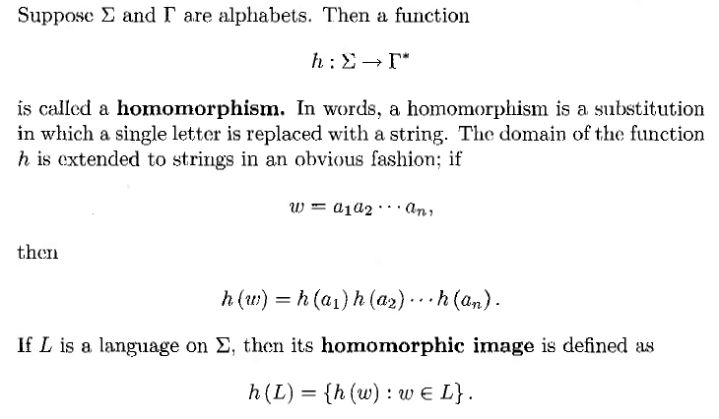

Slide 66
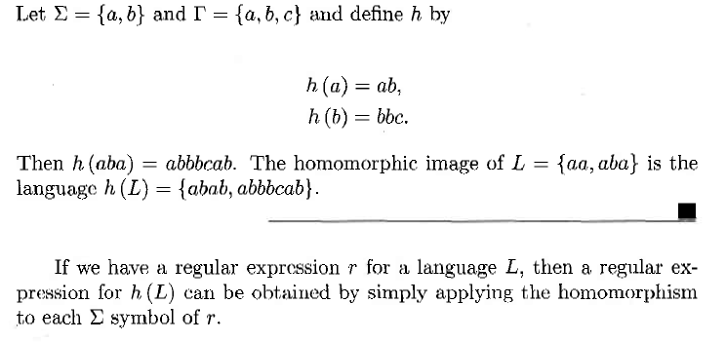

Slide 67
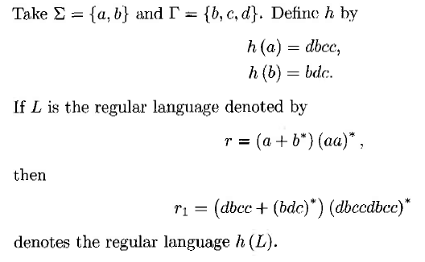

Slide 68
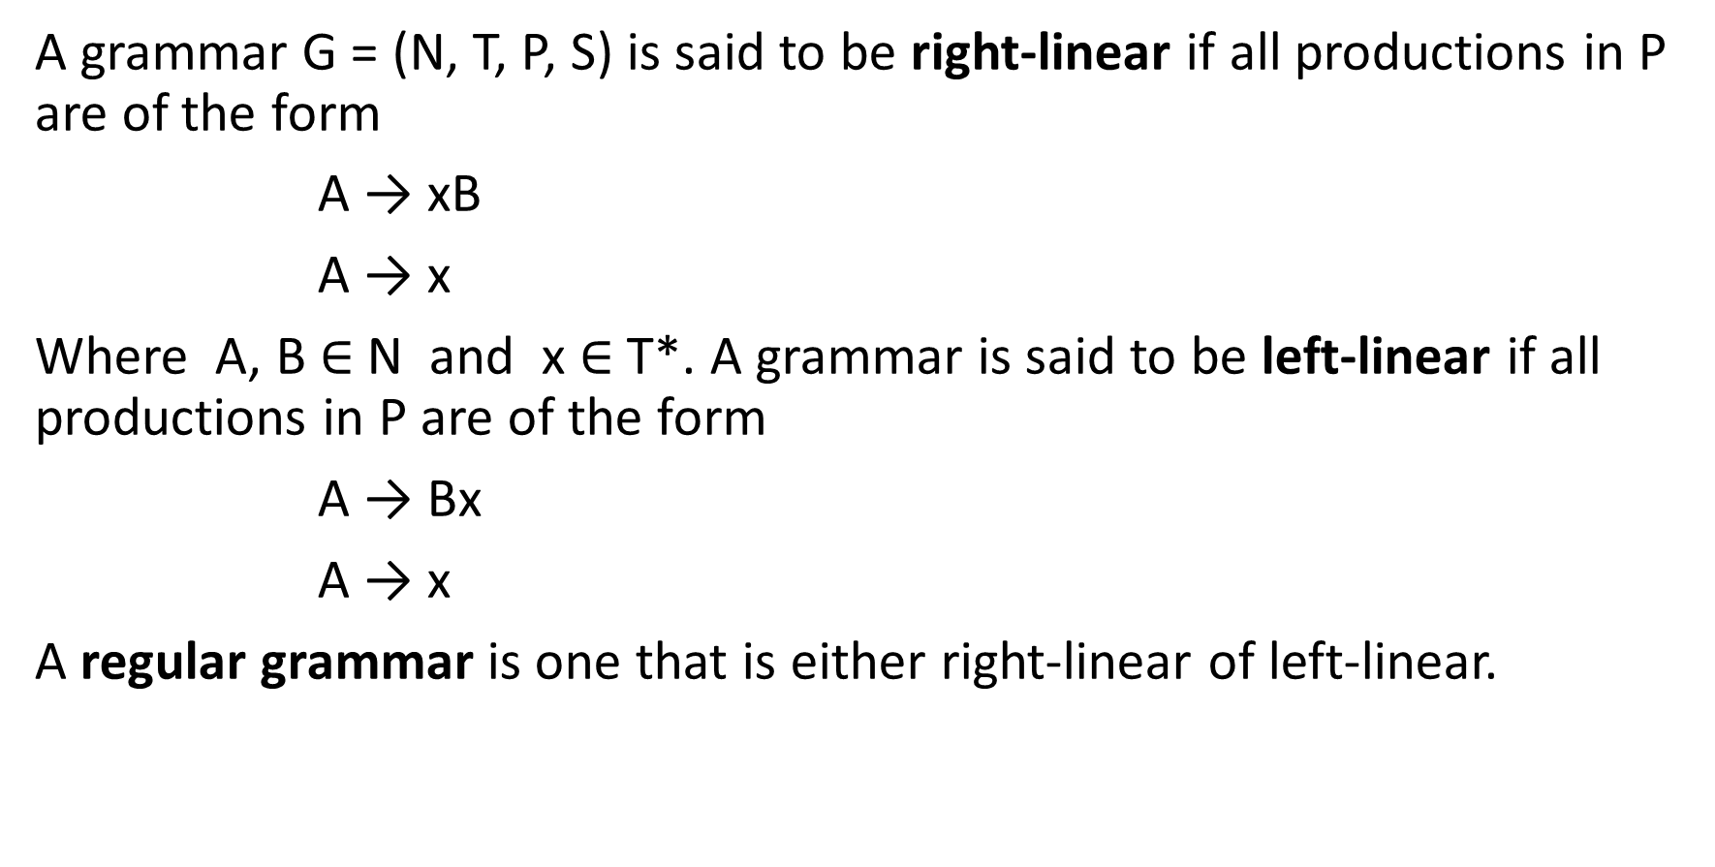
Linear Grammar
A grammar G = (N, T, P, S) is said to be right-linear if all productions in P are of the form
A → xB
A → x
Where A, B $∈$ N and x $∈$ T*. A grammar is said to be left-linear if all productions in P are of the form
A → Bx
A → x
A regular grammar is one that is either right-linear of left-linear.

Slide 69
Example:1
The grammar G= ({S}, {a, b }, P, S), where
P: S → abS
S → a
is right-linear. The language generated by this grammar is
L(G) = { (ab)^{n}a / n ≥ 0 }
Example:2
The grammar G= ({S, A, B}, {a, b }, P, S), where
P: S → Aab
A → Aab / B
B → a
is left-linear. The language generated by this grammar is
L(G) = { a(ab)^{n} / n ≥ 1 }

Slide 70
Example:3
The grammar G= ({S, A, B}, {a, b }, P, S), where
P: S → A
A → aB / ε
B → Ab
L(G) = { a^{n}b^{n} / n ≥ 0 }
This grammar is not regular. Since it is neither left-linear nor right-linear.
But this grammar is linear grammar.
Def: A linear grammar is a grammar in which at most one non-terminal can occur on the right side of any production, without restriction on the position of this non-terminal.

Slide 71
Example:4
Construct right and left linear grammars for the language
L(G) = { a^{n}b^{m} / n ≥ 2, m ≥ 3 }
P: S → aaA
A → aA / B
B → bbC
C → bC / b This grammar is right-linear.
P: S → Abbb
A → Ab / B
B → Ca
C → Ca / a This grammar is left-linear.

Slide 72
Recursively enumerable
Context-sensitive
Context-free
Linear
Finite
Regular

